Slide 1

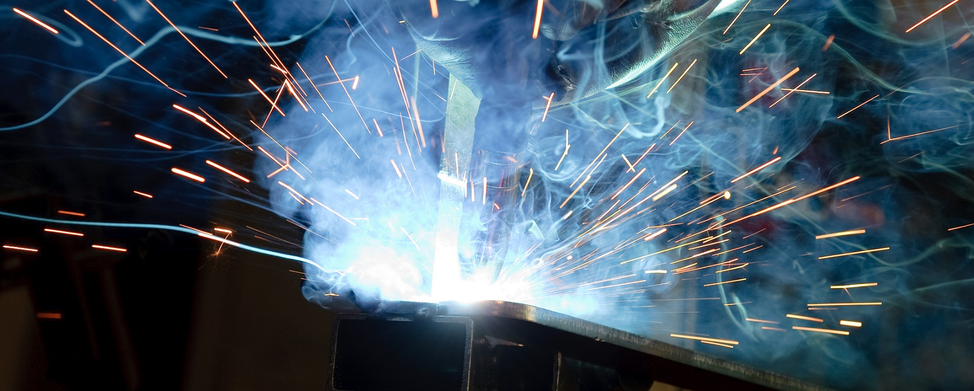
01752 201200
www.aldermantooling.co.uk
Seeking bright sparks
We’re one of the South West’s leading metal fabricators and an award-winning employer. We have a fantastic range of up-to-date machinery at our Plympton factory, and we work on interesting and challenging projects. No two days are the same.
We have a strong record of training apprentices, many of whom are still with us today. We’re pleased to announce we have three apprenticeship opportunities, to start in September 2026.
Metal Fabricator Apprentice
We are recruiting for a fabrication apprentice engineer to join us. This is a three-year apprenticeship, leading to a Framework NVQ Level 3 qualification in Engineering.
You’ll spend part of your week at City College Plymouth; alongside being trained here at Aldermans, working closely alongside many of our experienced fabricators. Once qualified, you’ll be able to operate CNC press brake machines to fold and bend sheet metal components, giving you valuable career skills.
You’ll also learn how to MIG/TIG, spot and stud weld, both freehand and from production jigs; and able to read and understand detailed technical drawings.
Engineering Design & Draughtsperson Apprentice
If creating, developing ideas and refining detailed engineering designs and drawings interests you, then this qualification could be for you.
You will be responsible for a variety of tasks including producing 2D and 3D CAD drawings, interpreting clients technical specifications, CNC programing and collaborating with our engineers to manufacture,
Maintenance & Operations Engineering Apprentice
If you’re a keen problem solver with an eye for detail and an analytic mind, this three-year apprenticeship could be your first step to a fantastic career in manufacturing.
Our Maintenance Engineers play a vital role in keeping our factory running – without them, we couldn’t make anything! During your apprenticeship you’ll learn how to undertake routine machinery inspections and preventative maintenance (such as replacing worn parts and checking oil levels).
You’ll install new machinery; and if a machine breaks down, you’ll get it going again as quickly as possible. You will also learn valuable core skills, such as how to understand electrical, plumbing, air conditioning, heating and electronic systems; and how to read blueprints and system schematics. Strong communication and organisational skills are essential for a successful Maintenance Engineer. You’ll also need to be physically fit enough to kneel, stand and lean over machines and move them around when required.
Successful Aldermans apprentices are practical and technically minded – bit we’re looking for character too.
We want someone who is keen to learn, reliable, punctual, a good communicator and a team player. It’s an advantage to have GCSE’s in Maths, English, Science and any practical subjects (grades 4 and above)
Your future is what you make it. Make it at Aldermans!

Slide 2
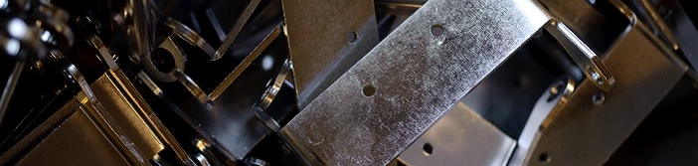
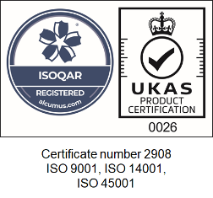
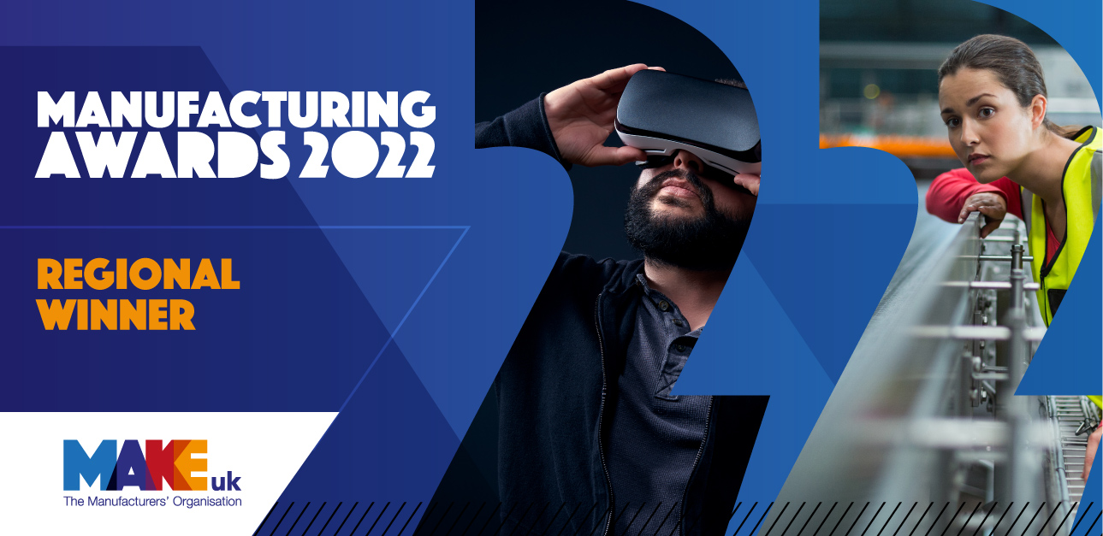




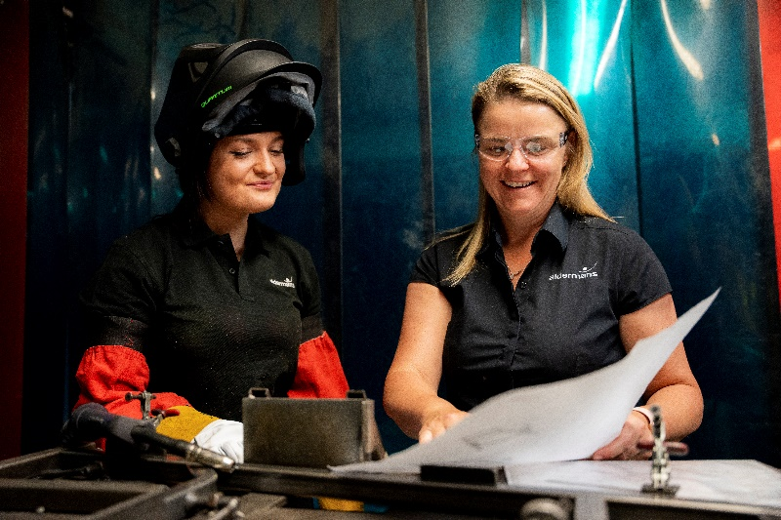
Integrated
Metal Fabrication
Award-winning employer
Quality is at the heart of all we do. We’re proud of our triple certification, to ISO 9001:2015 (quality),
ISO 14001:2015 (environmental)
and ISO 45001:2018 (health & safety) management standards.
We work as a key supply partner to many of the region’s leading manufacturers – so we create everything from automotive and railway parts, to components for specialist seating and data cabinets.
There are opportunities to learn and develop new skills in a friendly, supportive environment – which is why we are multiple award winners for our commitment to apprenticeships and training.
Additional quality credentials include: Advanced Quality Planning (AQP) techniques, FMEA, PPAP, ISIR, FAI and control planning.
Manufacturing capabilities
We’re committed to manufacturing efficiency.
We use lean techniques to ensure we offer a service which is both high-quality and cost-effective. We
have Six Sigma Green Belt qualified staff, helping us constantly analyse and improve our processes.
We offer:
Pressbrake folding – up to 170 tonnes
Power presses – with capacities up to 160 tonnes, and progression tools, with SMED quick change set-up
Amada CNC laser cutting / turret punching – multiple machines on a multi-shift system provide significant capacity. We offer 24hr turnaround on laser-only quotes
Saw cutting – batch or bespoke, angled or straight, with capability up to 6mm thick
Welding – extensive capacity on mig, tig and brazing mild, stainless steel and aluminium
De-burring, linishing, mirror polishing and powder coating of components
Assembly, sub-assembly and kit packing, so our clients have fewer suppliers to manage and an optimised supply chain
We are an equal opportunities employer and welcome applications from anyone who feels they have the relevant skills and experience for any role at Aldermans.
Please apply in writing, with a cover letter and your CV to:
Nicola Morrish
Nicola.Morrish@aldermantooling.co.uk
01752 201200
www.aldermantooling.co.uk
03/23

